Slide 1
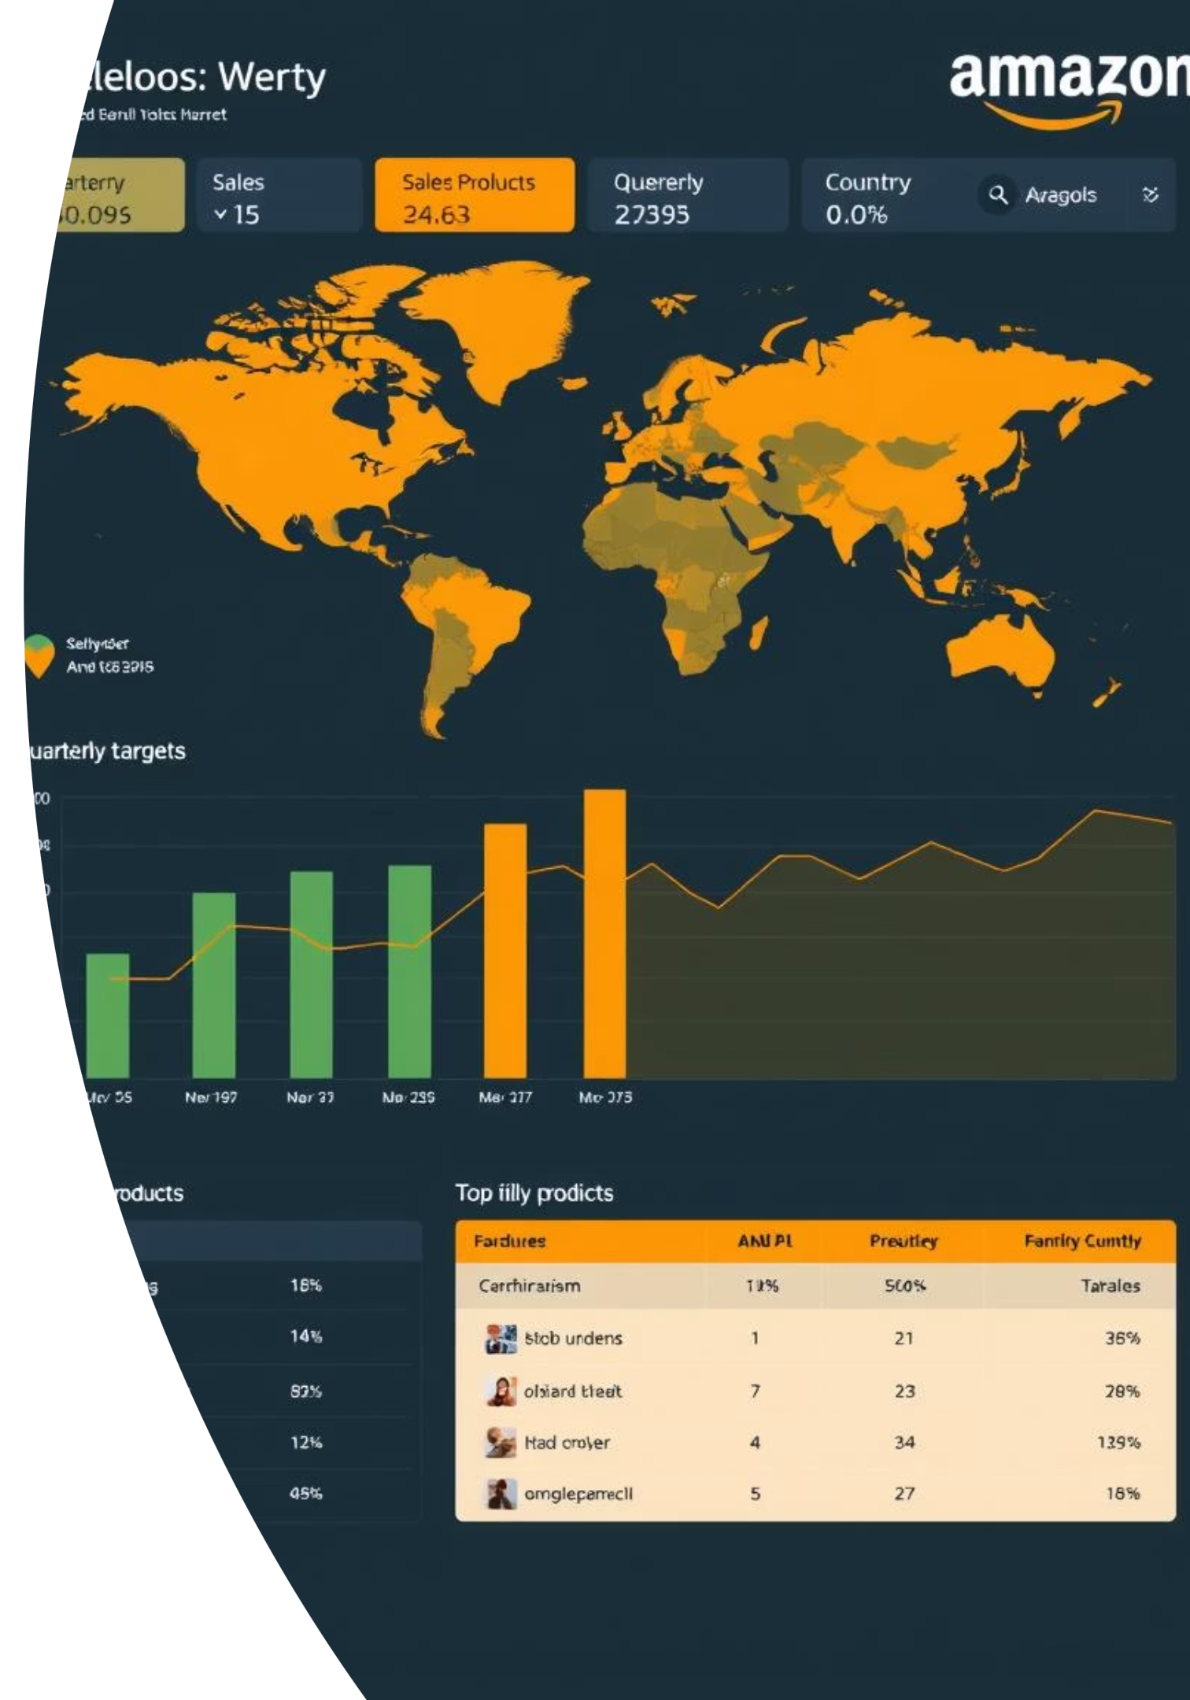
Amazon Sales Analysis Report
Data Cleaning with Python & Business Intelligence with Power BI
Presented by: Himanshu Kumar

Slide 2

Project Objective: Analyze and Provide Insights on Amazon Sales
The primary goal is to transform raw Amazon sales data into actionable insights. By focusing on key areas, we empower strategic decision-making and optimize business performance.
Analyze sales trends and product performance.
Evaluate fulfillment efficiency and identify areas for improvement.
Understand customer behavior and regional sales dynamics.

Slide 3

Amazon Sales Data Overview
The dataset comprises comprehensive sales information, providing a holistic view of Amazon's operational and customer landscape.
Key Columns: Order ID, Date, Category, Quantity, Amount, Fulfillment Status, Shipping City, Shipping State.
Dataset Size: Over 120,000 rows of transaction data.
Source: Proprietary Amazon sales records, anonymized for analysis.

Slide 4

Data Cleaning & Preparation with Python & Power Query
Robust data cleaning was essential to ensure the accuracy and reliability of our analysis, laying a solid foundation for insightful reporting.
Pandas for Initial Cleaning
Utilized Python with Pandas to efficiently handle missing values, correct data types, and standardize formats across the dataset.
Power Query for Transformations
Applied Power Query within Power BI to group delivery statuses and create a unified "Status Group" for streamlined analysis.
RFM Metrics Generation
Engineered new columns for Recency, Frequency, and Monetary (RFM) values, enabling advanced customer segmentation.

Slide 5
Interactive Dashboard Features in Power BI
Key Performance Indicators (KPIs)
Visualizations Utilized
Total Revenue
Sales Trend Line Chart for Montlhy sales analysis.
Total Orders
Top Categories Bar Chart to highlight best-selling products.
Average Order Value
Order Count
100% Stacked Bar for Fulfillment Status breakdown.
RFM-based Customer Segmentation for targeted marketing.
Dynamic Slicers
Date Range
Top Cities Table with Top 8 filter for regional focus.
Bar chart for State wise sales and orders
Status of Delivery
Fulfillment Method

Slide 6

Key Insights & Analytical Findings
Through meticulous analysis of the dashboard, several critical observations have emerged, guiding our strategic recommendations.
Fulfillment Efficiency
Geographic Performance
Amazon-fulfilled orders have higher shipment rates but LOWER delivery confirmation than Merchant-fulfilled. Investigate potential delays in Amazon’s delivery confirmation process
.Merchant-fulfilled orders show higher cancellation rates. Improve merchant logistics or communication to reduce cancellations.
Maharashtra, Karnataka, and Telangana are key markets. Strengthen logistics and warehousing in these regions (e.g., Bengaluru, Hyderabad, Mumbai)
.Expand marketing in high-growth cities like New Delhi and Chennai to capture more market share.
Product Performance
T-Shirts and Shirts dominate sales, contributing 88% of revenue. Focus inventory and marketing efforts on these categories, especially M, L, and XL sizes.
Blazzers and Trousers have potential for growth, given their higher price points. Targeted promotions could boost their share.

Slide 7




Actionable Recommendations for Growth
Optimize Fulfillment
Increase FBA Enrollment: Shift 80-85% of inventory to FBA for faster processing and Prime eligibility. Target: Boost FBA orders by 5% in 3 months.
Improve Delivery Confirmation: Collaborate with Amazon to enhance last-mile tracking, increasing confirmation rate to 20% in 2 months.
Targeted Marketing
Expand to Emerging Markets: Invest 20% of budget in Uttar Pradesh, Tamil Nadu (New Delhi, Chennai). Test campaigns in Jaipur. Festive Promotions: Plan campaigns for Diwali/Christmas, focusing on high-margin Blazzers/Trousers.Target: Boost sales by 20% during festive seasons.
Product Bundling
Prioritize Inventory: Stock 70-80% T-Shirts/Shirts in M, L, XL sizes, reduce 3XL/5XL stock (<5% of orders).Target: Optimize inventory to avoid overstocking.
Clear Slow-Moving Stock: Offer 20-30% discounts or bundles (e.g., T-Shirt + Perfume) for Perfume/Socks.Target: Clear 50% of low-demand inventory in 2 months.

Slide 8
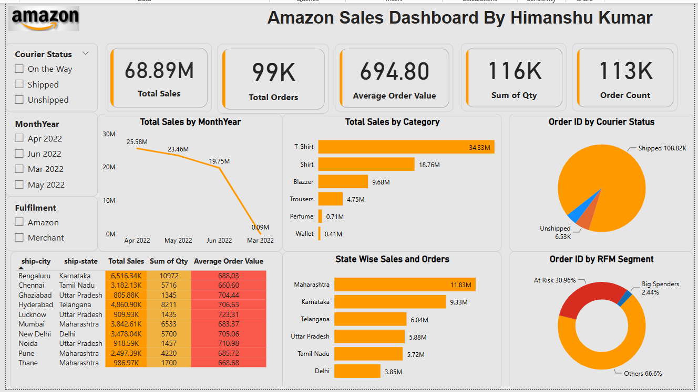

Slide 9
THANK YOU

